Slide 1
A ppt on GENOME ASSEMBLY
- KISHOR KUMAR SARKER

Slide 2
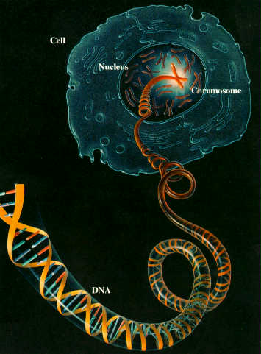
Genome!!!
Entire information of inheritance
Types
Nuclear
Mitochondrial

Slide 3
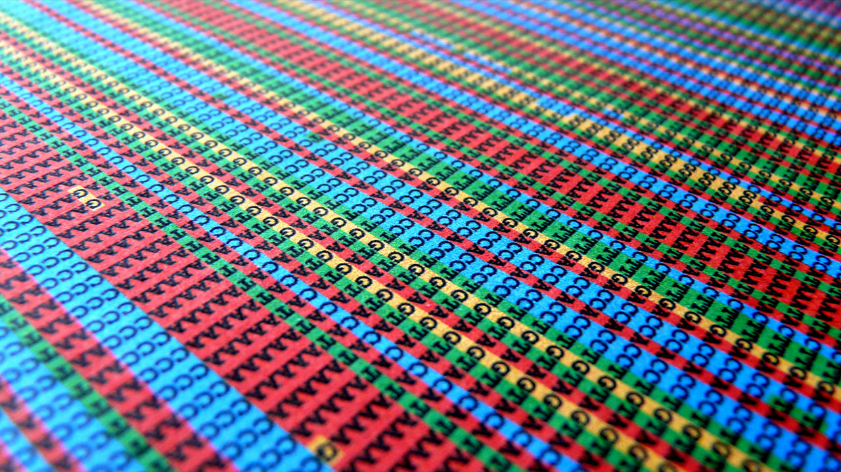
Its all about 4 letter (A, T, C & G)

Slide 4
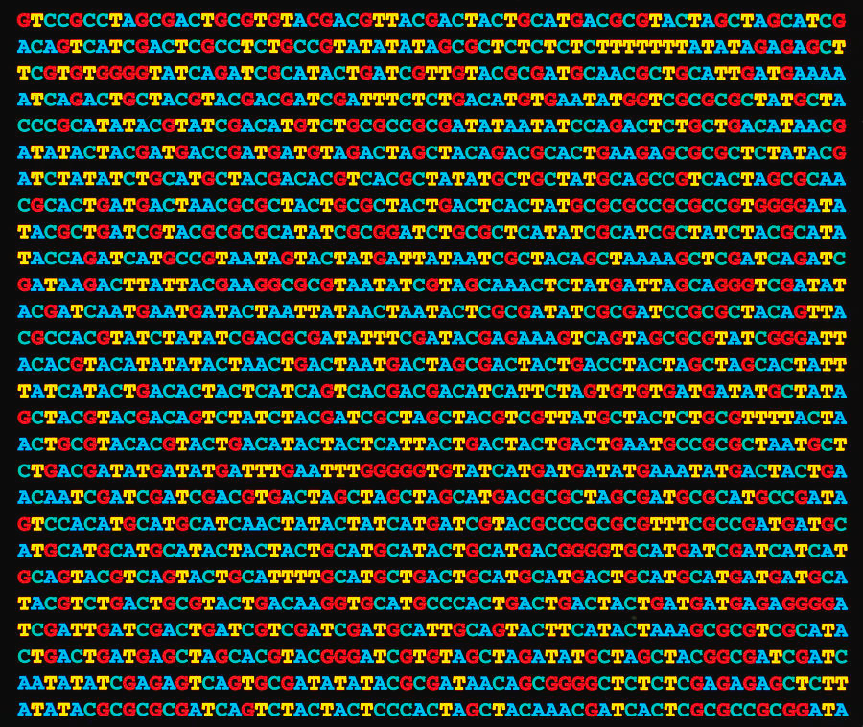
What is a sequence? -the order of nucleotide

Slide 5
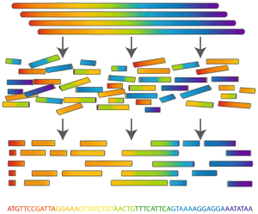
What is genome assembly?
-the hierarchical order of sequences or the alignment of sequences

Slide 6
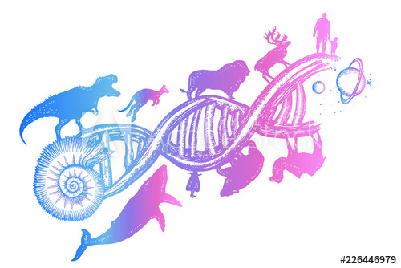
Why assembly is needed?
To know about- 1. evolution 2. speciation 3. mutation 4. adaptation 5. disease development etc.

Slide 7
Basic Workflow
1. Tissue
2. Genetic Material
3. Library Preparation
5. Assembly
4.Sequencing

Slide 8
Sequencing Method

Slide 9
Sanger
Sequencing is based on PCR
ddNTPs are prime feature here to look out.

Slide 10
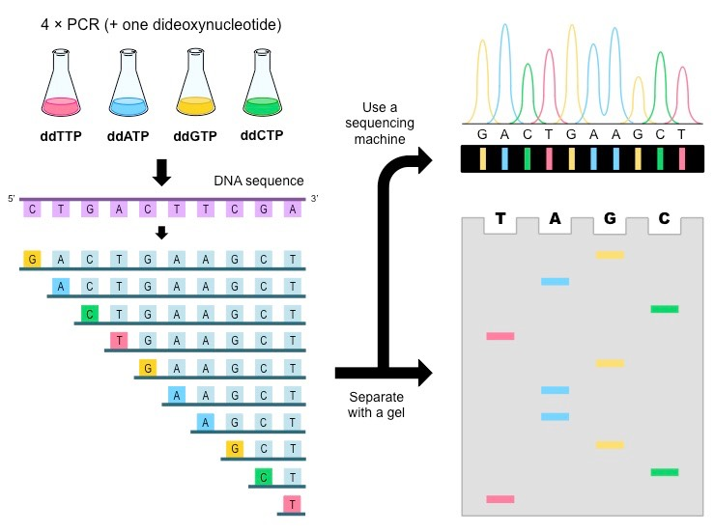

Slide 11
Advantages-
Accuracy (99.99%)
Large read length (up to 800 bp)
Disadvantages-
Consume more Time (e.g. 13 year for human genome)
Highly expansive (3billion for human genome)
Low throughput

Slide 12
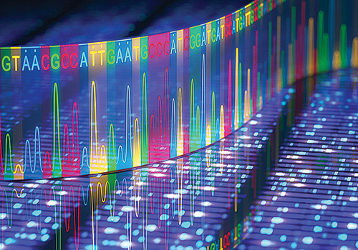
ILLUMINA

Slide 13
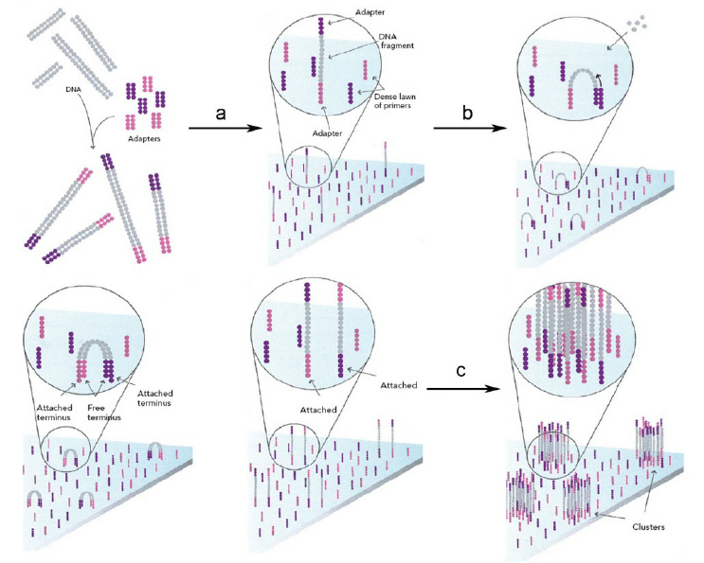
Key points- Adapter oligo, Bridge Amplification, Cluster generation, Fluorescently labeled nucleotides

Slide 14
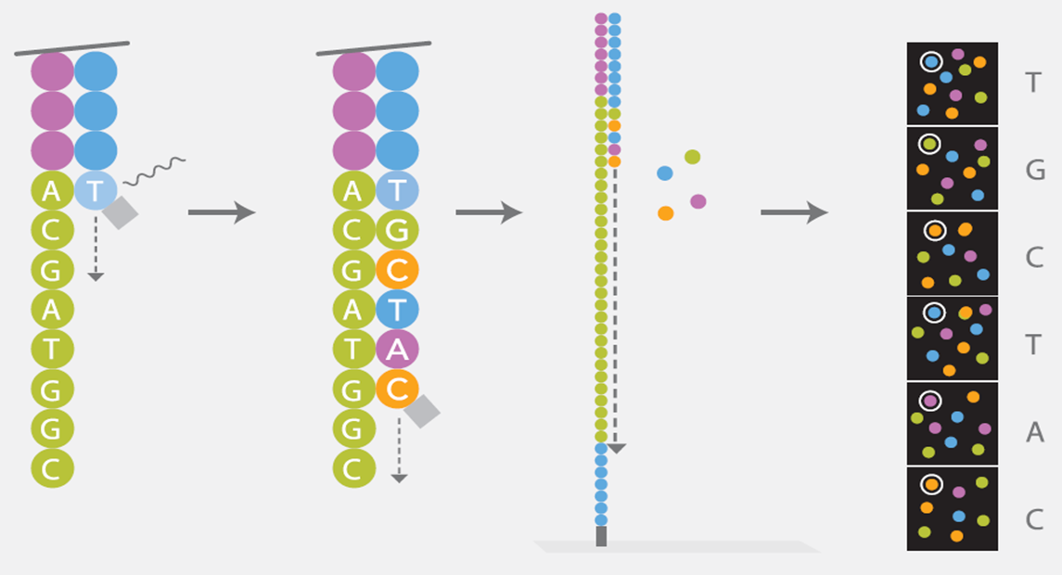

Slide 15
Advantages-
Low cost (1000 to 3000 USD for a human genome)
High throughput
Time saving
Disadvantages
Repeats
Shorter read length(~250 bp)

Slide 16
Pacbio
Real-time sequencing
It enables simultaneous collection of data from millions of wells using the natural process of DNA replication to sequence long fragments of native DNA or RNA.
No need for clonal amplification of DNA

Slide 17
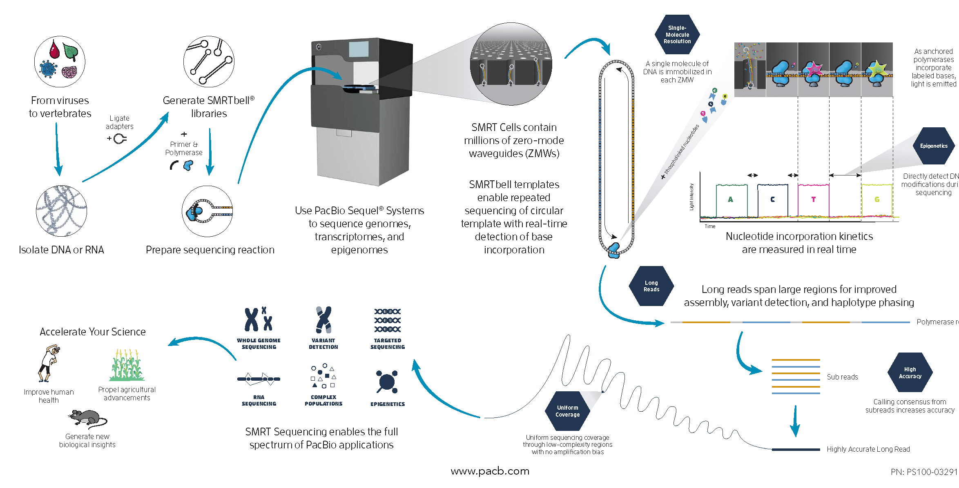

Slide 18
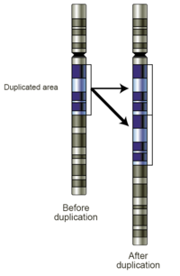
Advantages
Long read, mean 10 to 15kb
Repeat, Deletion, Alteration, Insertion, Duplication can be traced in between the read.
Less time (30min to 180min)
Disadvantages
Error rate (5-10%)

Slide 19
Nanopore
Based on using electric current
Fragments are dropped into a pore (1nm) on silica plate that is surrounded with iron
Each type of adding dNTP alter the magnitude of the current
Magnitude of the current influenced by shape and size of the pore
Motor protein acts as a dragging force to attach with the well

Slide 20
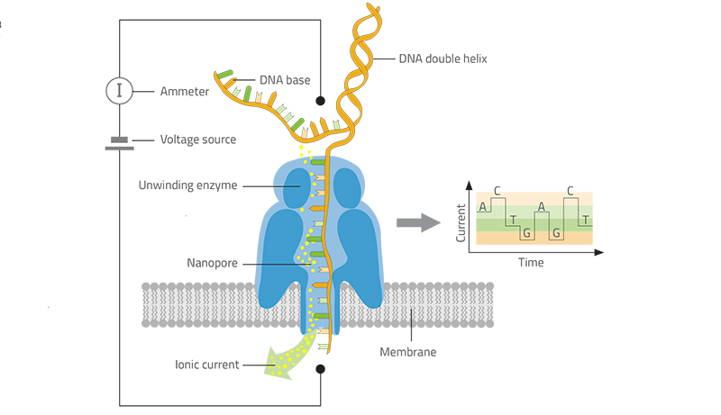

Slide 21
Advantages
400 bases per second
Read length varies upto 1000kb
Disadvantages
Error rate 10 to 15%

Slide 22
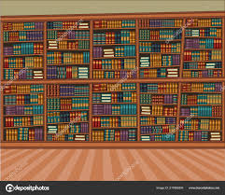
Library
Many copies of many books!!!!

Slide 23
Library Methods for Genomic DNA-
NGS
Mate pair
Hi-C
10x Genomics

Slide 24
What is NGS?
NGS stands for New Generation Sequencing.
The basic next-generation sequencing process involves fragmenting DNA/RNA into multiple pieces, adding adapters, sequencing the libraries, and reassembling them to form a genomic sequence.
Millions of short reads (~250bp) can be produced within a minimal requirement of time.

Slide 25
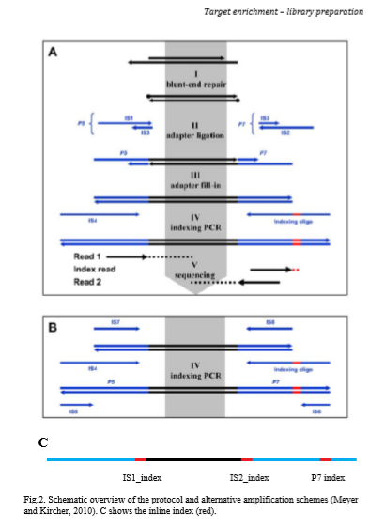

Slide 26
Mate Pair
Why we do that?
Allows to obtain long inserts
Maximal sequence capture
Basics of Library
Fragments are end repaired and circularized
Non circulated fragments are washed out
Circular DNA fragments are then cut into 200-500 bases.

Slide 27
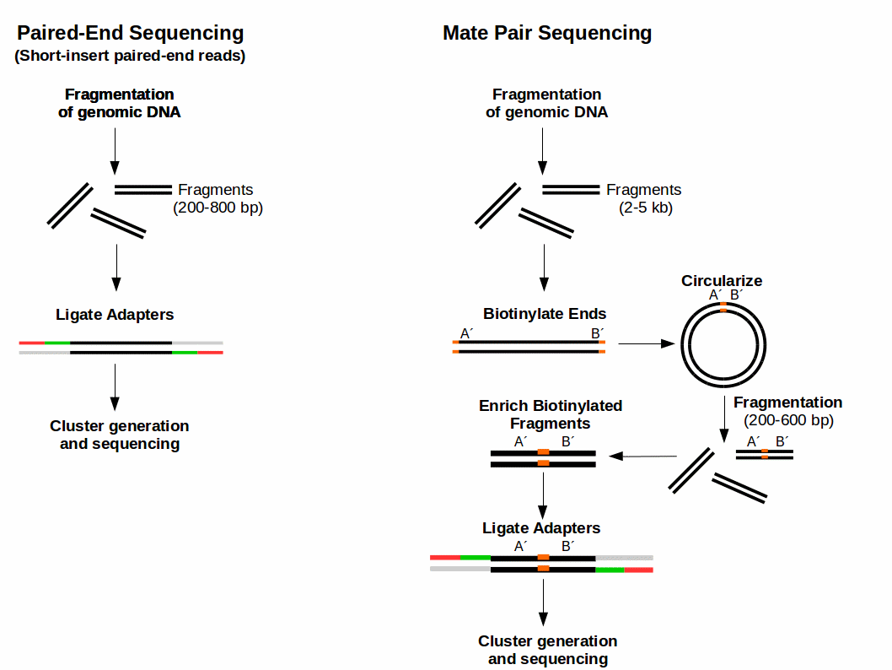

Slide 28
Hi-C
What is Hi-C?
Hi-C is a genome wide Chromatin Conformation Capture protocol using proximity ligation.
Hence, it is the method of choice for the chromosome-scale scaffolding of genome assemblies.

Slide 29
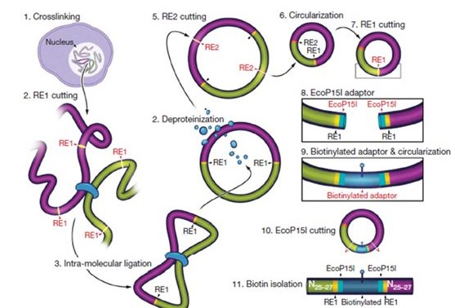

Slide 30
10x genomics
The 10X Genomics technology generates individually barcoded sequencing libraries for hundreds of thousands of nano liter volume oil droplets using up to 1.7 million different barcodes.
Key features to look here- Beads, Barcode, Primer and oil droplet.

Slide 31
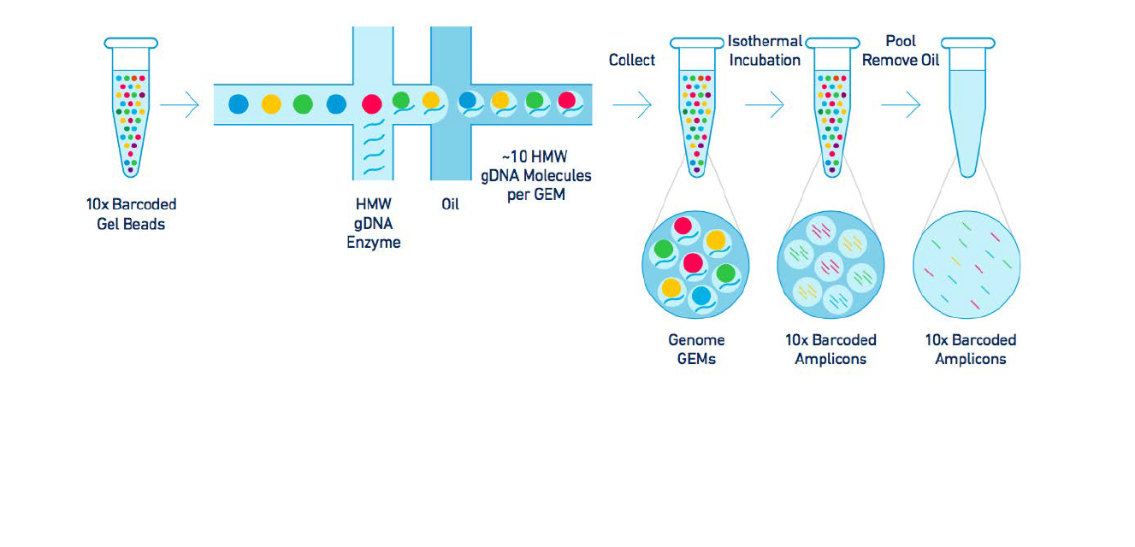

Slide 32
Before assembly need to know..
Read- A particular sequenced portion of a read.
Contig- Assembly of short reads
Scaffold- Supercontig

Slide 33
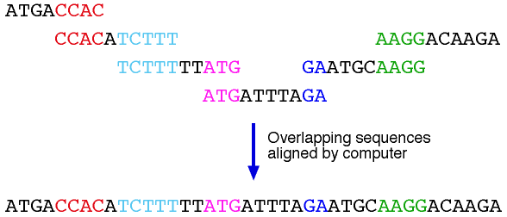
Algorithms
OLC- Stands for ‘overlap’, ‘Layout’ and ‘Consensus’.
Overlap

Slide 34
Consensus..??

Slide 35
de Bruijn Graph (dBG)
The standard de Bruijn graph is the graph obtained by taking all strings over any finite alphabet of length n as vertices, and adding edges between vertices that have an overlap of n-1.

Slide 36
Things to look out..
K-mer: k-mers are subsequences of length contained within a biological sequence.
Hamiltonian path: A Hamiltonian path is a graph path between two vertices of a graph that visits each vertex exactly once.

Slide 38
Assembler
ABySS-ABySS is a de novo, parallel, paired-end sequence assembler that is designed for short reads.
Download Link:
$ git clone https://github.com/bcgsc/abyss.git

Slide 39
SOAPdenovo-SOAPdenovo is a novel short-read assembly method that can build a de novo draft assembly for human-sized genomes. The program is specially designed to assemble illumina short reads. It creates new opportunities for building reference sequences and carrying out accurate analyses of unexplored genomes in a cost effective way.
Download Link: http://soap.genomics.org.cn/soapdenovo.html

Slide 40
2. how to ‘Get it started’
Once the configuration file is available, a typical way to run the assembler is: ./soapdenovo all -s config_file -K 25 -R -o graph_prefix User can also choose to run the assembly process step by step as: ./soapdenovo pregraph -s config_file -K 25 [-R -d -p] -o graph_prefix ./soapdenovo contig -g graph_prefix [-R -M 1 -D] ./soapdenovo map -s config_file -g graph_prefix [-p] ./soapdenovo scaff -g graph_prefix [-F -u -G -p]

Slide 41
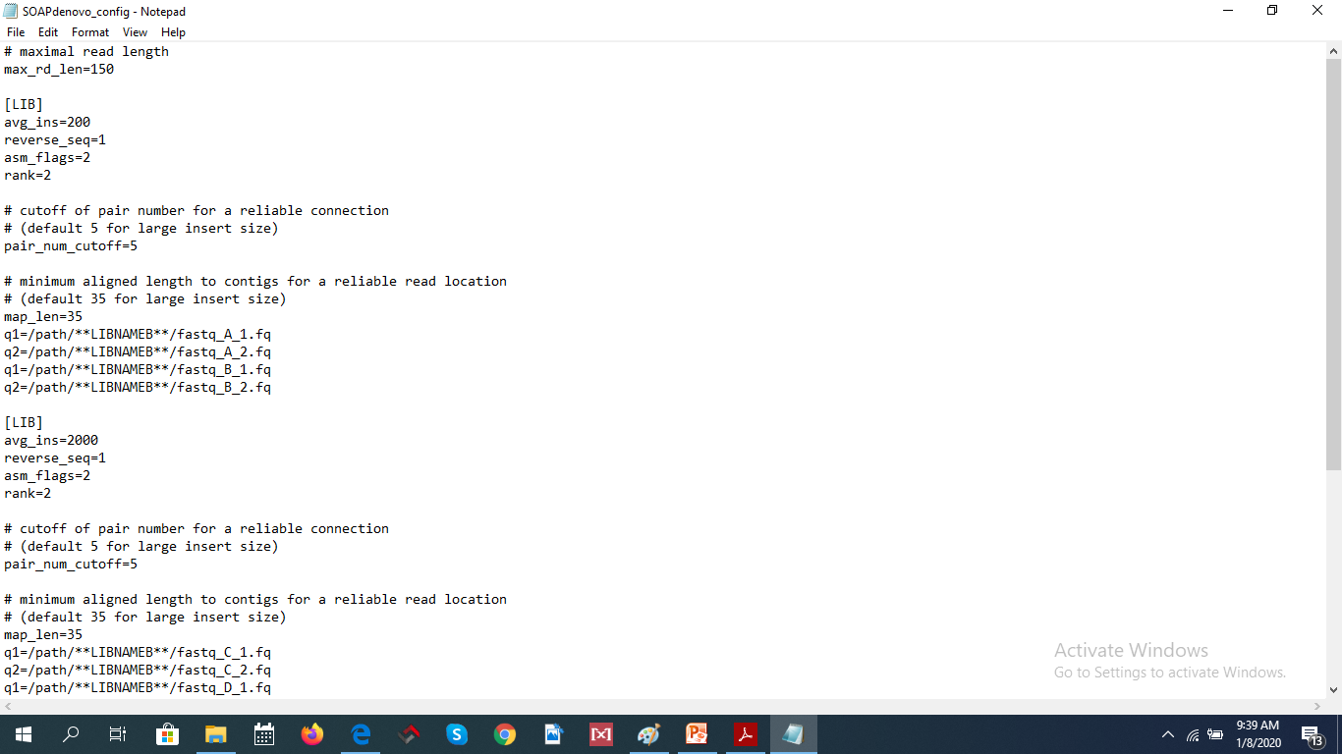

Slide 42
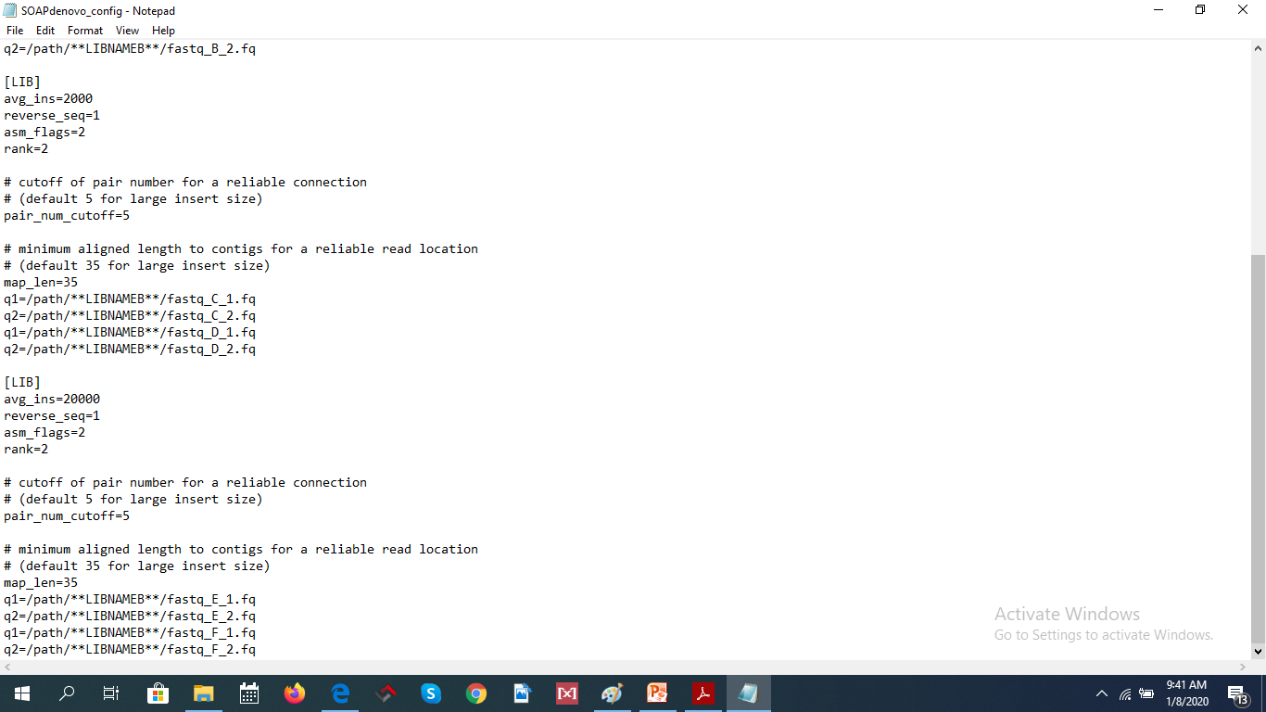

Slide 43
CANU
Canu specializes in assembling PacBio or Oxford Nanopore sequences.

Slide 44
Supernova
Allows to create true diploid de novo assemblies. Supernova can separate homologous chromosomes over long distances, in this sense capturing the true biology of a diploid genome.
Information Link: https://omictools.com/supernova-tool

Slide 45
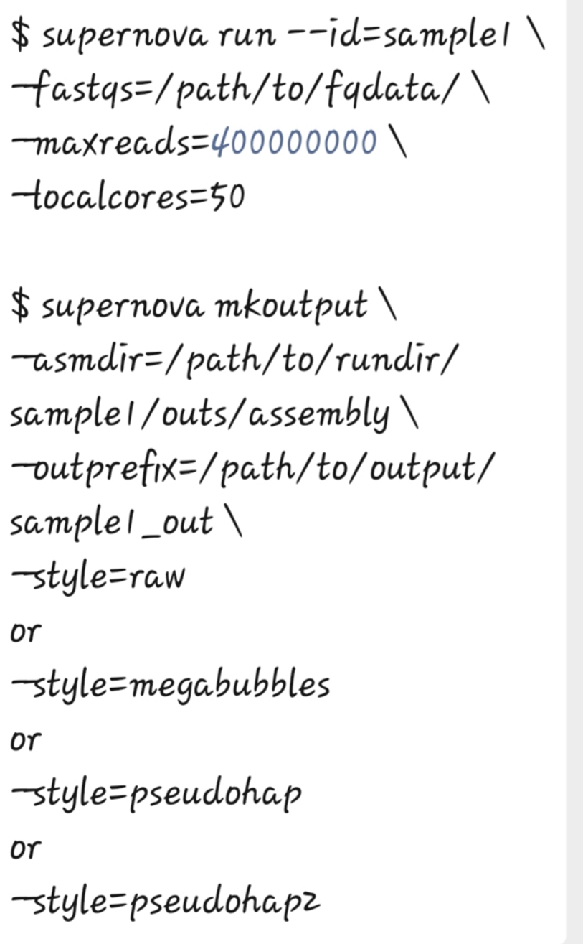
Basic Command Line

Slide 46
THANKS TO ALL……………

